Slide 1
IN-VEHICLE COUPON RECOMMENDATION SYSTEM
IE 7300
STATISTICAL LEARNING FOR ENGINEERS
PROJECT OVERVIEW
PRESENTED BY
GROUP 11
ACHALA SHENOY ANKITA SHUKLA
NAVYA PRAGATHI MOLUGARAM SANIDHYA MATHUR

Slide 2
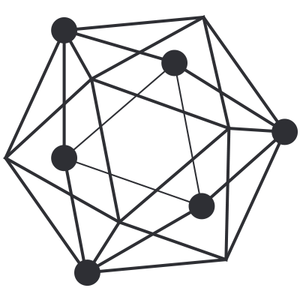
INTRODUCTION
PROBLEM SETTING: -
In the realm of marketing strategy, understanding consumer behavior is paramount
The issuance of coupons as an incentive for patronage is a common tactic, but its effectiveness varies widely
Recognizing the intricate interplay of factors that influence coupon redemption can significantly enhance the efficiency of such campaigns
PROBLEM DEFINITION: -
The Main objective of this Project is :-
Develop a predictive model capable of discerning the likelihood of coupon redemption based on number of contextual factors
To create a tool that can assist marketers in optimizing coupon distribution strategies

Slide 3
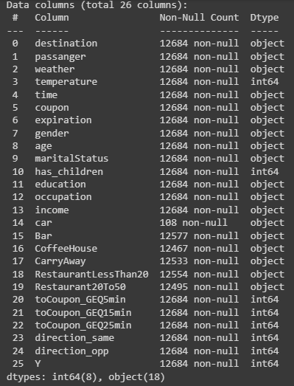
DATA DESCRIPTION
The dataset comprises 12,684 entries with 26 columns. The columns represent various aspects of consumer behavior related to coupon redemption
The dataset includes 8 numerical columns (`int64`) and 18 categorical columns (`object`) including the target variable

Slide 4
METHODS IMPLEMENTED
Data Cleaning
Handling Missing Values
Column Removal
Feature Engineering
Categorical Variable Encoding
Ordinal Variable Encoding
Age and Occupation Grouping
Dimension Reduction
PCA

Slide 5
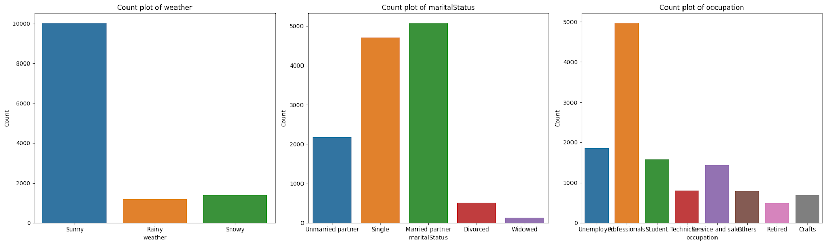
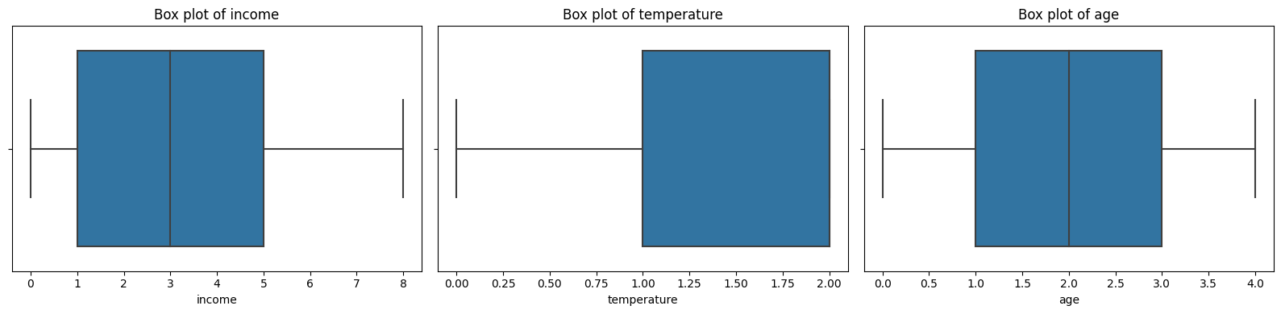
EXPLORATORY DATA ANALYSIS
Class Distribution: Partially balanced dataset with 57% acceptance and 43% rejection class labels.
Count Plots for Categorical Variables: Visualize distributions of weather, marital status, and occupation.
Quick Overview of Category Frequencies: Offers insights into dominant factors within the dataset.
Box Plots for Numerical Features: Depict spread and central tendency.
Visual Summary of Distribution: Highlights outliers and data variability.

Slide 6
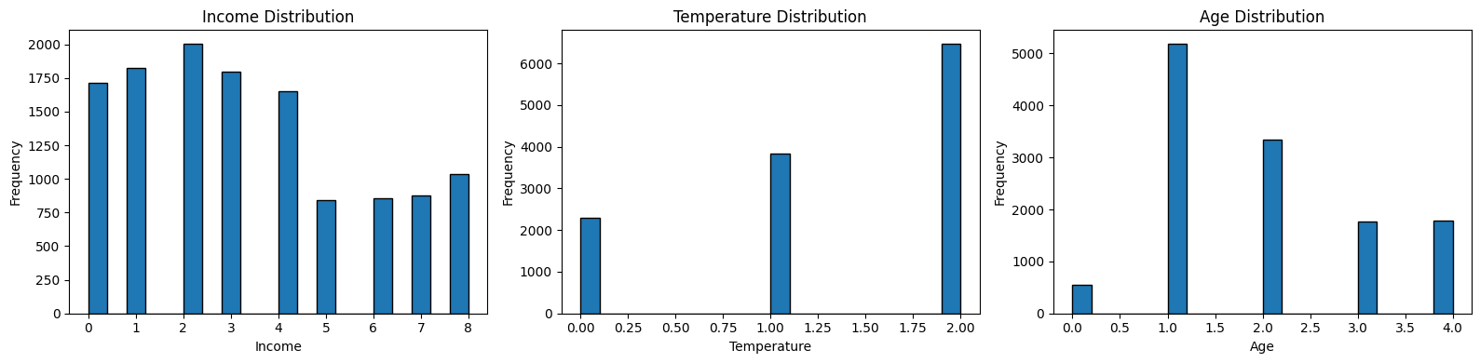
EXPLORATORY DATA ANALYSIS
Histograms for Numerical Features: Showcases distributions of variables like income, temperature, and age.
Identifying Patterns & Central Tendencies: Crucial for understanding data diversity and ranges.
Income Distribution Peaks: Observed at levels 2, 3, and 4, showing variations across the income spectrum.
Temperature Categories: Three categories (0, 1, 2) with temperature 2 being the most prevalent.
Age Distribution: Spanning categories 1 to 4, with age 1 having the highest frequency.

Slide 7
MODEL SELECTION
For this project we will build machine learning models, which will be capable of discerning the likelihood of coupon redemption based on number of contextual factors
Machine Learning Models Implemented
Naïve Bayes
Logistic Regression
Neural Networks
K-Nearest Neighbors (KNN)

Slide 8
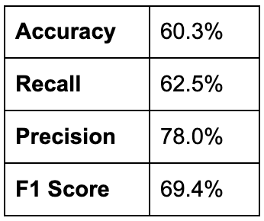
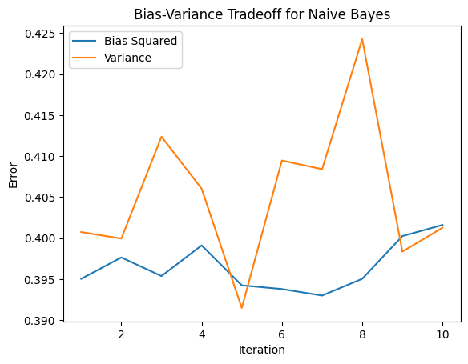
NAIVE BAYES
Operates on the principle of Bayes' theorem
Perform probabilistic classification
Assess the accuracy of the model​

Slide 9
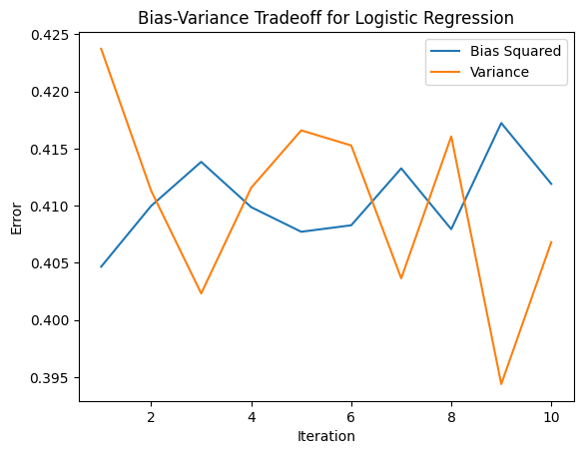
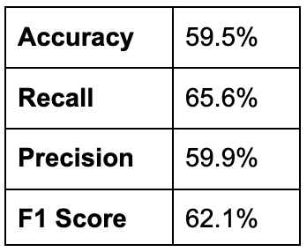
LOGISTIC REGRESSION
Statistical method used for predicting the probability of a binary outcome
Minimized the cost using gradient descent
Assess the accuracy of the model​​

Slide 10
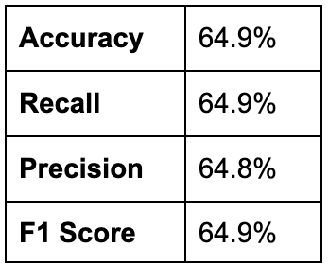
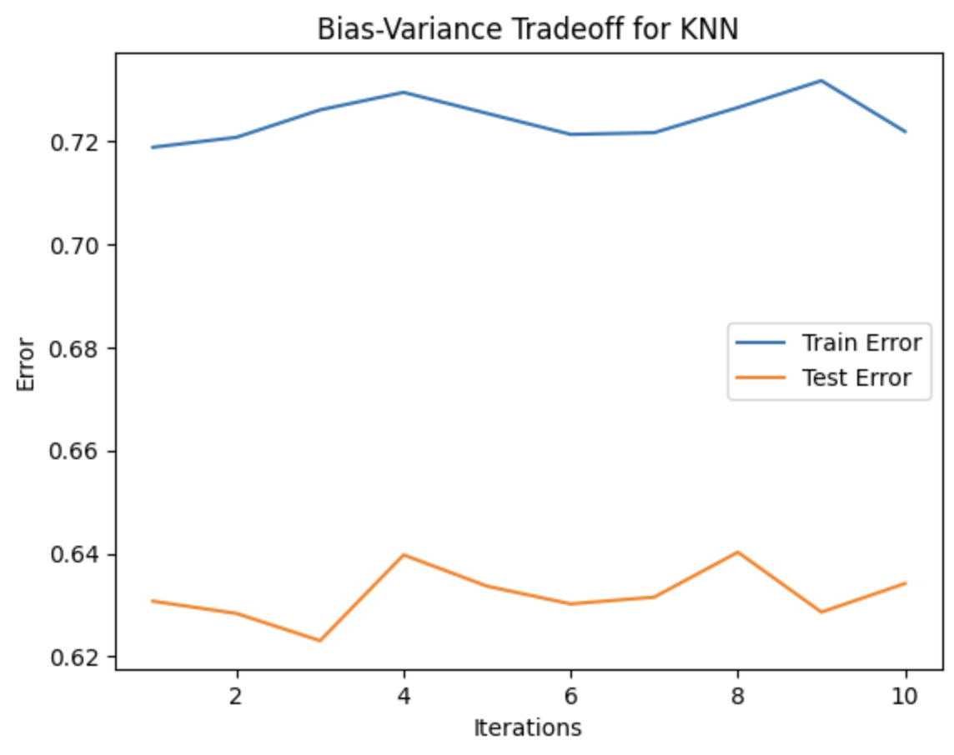
K-NEAREST NEIGHBORS (KNN)
Instance-based learning
Model makes predictions based on the similarity of input data points
Predict coupon redemption by considering the features and characteristics of consumers

Slide 11
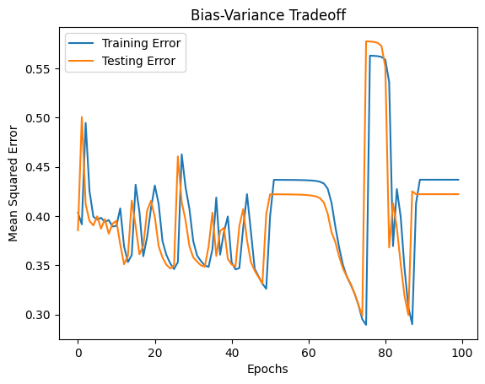
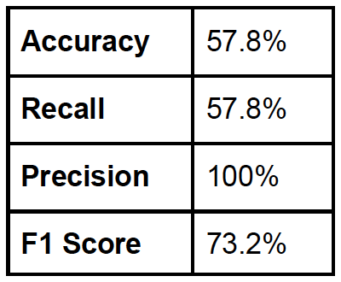
NEURAL NETWORKS
Input layer: Information passed to the model​
Hidden layer: Group of neurons where calculations are done.
Output layer: Result of the calculations where output node can be single or several nodes depending on the problem​
Applied as a predictive model to discern complex, non-linear relationships within the dataset
Error is determined after receiving the predictions​

Slide 12
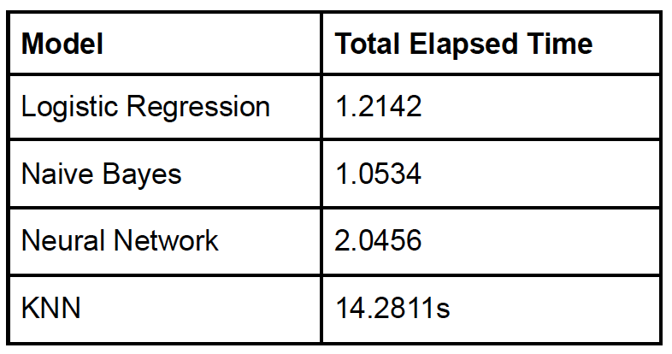
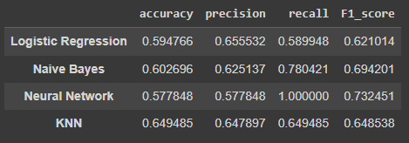
CONCLUSION
Optimal F1 Score: The Neural Network exhibits the highest F1 score, signifying a commendable equilibrium between precision and recall
Balanced Training and Testing Errors: Despite overfitting, the alignment between training and testing errors denotes a well-balanced model
Leveraging Non-linear Capabilities: The dataset stands to gain from the Neural Network's non-linear capabilities, adept at capturing intricate and complex relationships within the data

Slide 13
LIMITATIONS AND FUTURE DIRECTIONS
Limited Dataset Size (12,684 entries): Potential limitation for model generalization
Feature Space Constraints: May overlook vital aspects of consumer behavior, impacting predictive ability
Model Assumptions Mismatch: Assumptions of chosen models might not fully align with the data distribution
Imbalanced Class Distribution: Challenges in accurately predicting minority classes, affecting model performance
Ensemble Model Exploration: Utilizing models like Random Forests, Gradient Boosting to improve generalization
Deep Learning Architectures: Consideration for capturing intricate relationships in the data
External Feature Investigation: Exploring additional external features to enrich understanding of consumer behavior

Slide 14
THANK YOU

